Slide 2
Lens of Equity Series
PART ONE
PART TWO
PART THREE
PART FOUR
SUMMIT EVENT
PEOPLE
PRACTICE
POLICY
PROMOTION
SUMMIT
February 3, 2021
The importance of organizational culture with the people in the center.
March 3, 2021
Addressing policy and procedures to create equitable and inclusive practices.
April 7, 2021
How to put DEAI in the center of an organization’s daily processes.
May 5, 2021
Highlighting organizations that are in the process of placing DEAI in their current practices.
June 18, 2021
Highlighting organizations that are in the process of placing DEAI in their current practices.

Slide 3
Organizational Structures Committee
Past projects
Housing of resources including a Lexicon, Resource/Educational Guide, and Organizational Assessment
4-part Lens of Equity mini-series.
Future projects
Lens of Equity Summit in June
Gold Standard Onboarding Process
Growing resources
Committee meets monthly on the third Thursday of the month at 10:00 am.
Next Meeting: February 18th at 10:00 am

Slide 4
PART ONE
PEOPLE
TEAM MEMBERS
Empathetic Leadership: Your People, Your Culture.
Tunisia Price tprice@piercetransit.org
Sarah Ciambrone sarah@hopesacpc.org
Alice Massara amassara@cityoftacoma.org
Karissa Thompson kthompson@redcanoecu.com

Slide 5
PART ONE
Agenda
PEOPLE
Empathetic Leadership: Your People, Your Culture.
Organizational Culture & Team Connection
Karissa Thompson
Employee Engagement
Tunisia Price

Slide 6
Statistics supporting importance of Organizational Culture by Built In www.builtin.com
58%
of employees would stay at a lower-paying job if it meant working for a great boss.
61%
of employees cite trust in senior management as important to their satisfaction.
88%
of employees believe a strong organizational culture is key to business success and 94% of executives feel the same.
57%
of workers are more loyal, productive, and take less time off when employers support their mental well-being.
26%
Employees are 26% more likely to leave their jobs if they feel there is a lack of respect between colleagues.

Slide 7
Definition of Organizational Culture
Organizational culture can be defined as:
”A set of shared values, goals, attitudes and practices that characterize an organization.”
Your team will develop a culture whether intentionally or not.

Slide 8
Deep Dive into Culture: Shared values
Organizational leaders can’t force shared values — nor should they try.
Each individual has their own set of personal and professional values, and this diversity is key to strong work cultures.
Leadership can create a culture that helps foster these important connections.
Leverage your organization’s Vision & Mission
Use mentorship to foster connections among coworkers
Measure employee engagement within your organization

Slide 9
Deep Dive into Culture: Shared goals
When you set organizational goals, get your team involved.
Let them help with short term and long-term planning; this creates buy in. Maybe they will help you see something you may not have thought about.
A team that plans together, stays together
Ask your team to set individual goals as well as team goals
Identify what your team needs from leadership to ensure success by specifically asking the questions and listening (trainings, check-ins, accountability meetings etc.)

Slide 10
Deep Dive into Culture: Shared attitudes
The Experience
Develop an environment where people are excited to be asked the stupid questions over and over
Walt Disney
Photo Credit: Alamy

Slide 11
Deep Dive into Culture: Shared practices that characterize your organization
What are your expectations in organizational norms through practices? (the No Matter Whats)
How can your team expect to be treated by leadership and each other? What do those practices look like?
How does your team treat your clients? What practices are in place to create a positive client experience?
What are the expectations for reporting and correcting bad behavior, especially if it doesn’t fit with the culture? Additionally, do you have expectations for reporting good behavior?

Slide 12
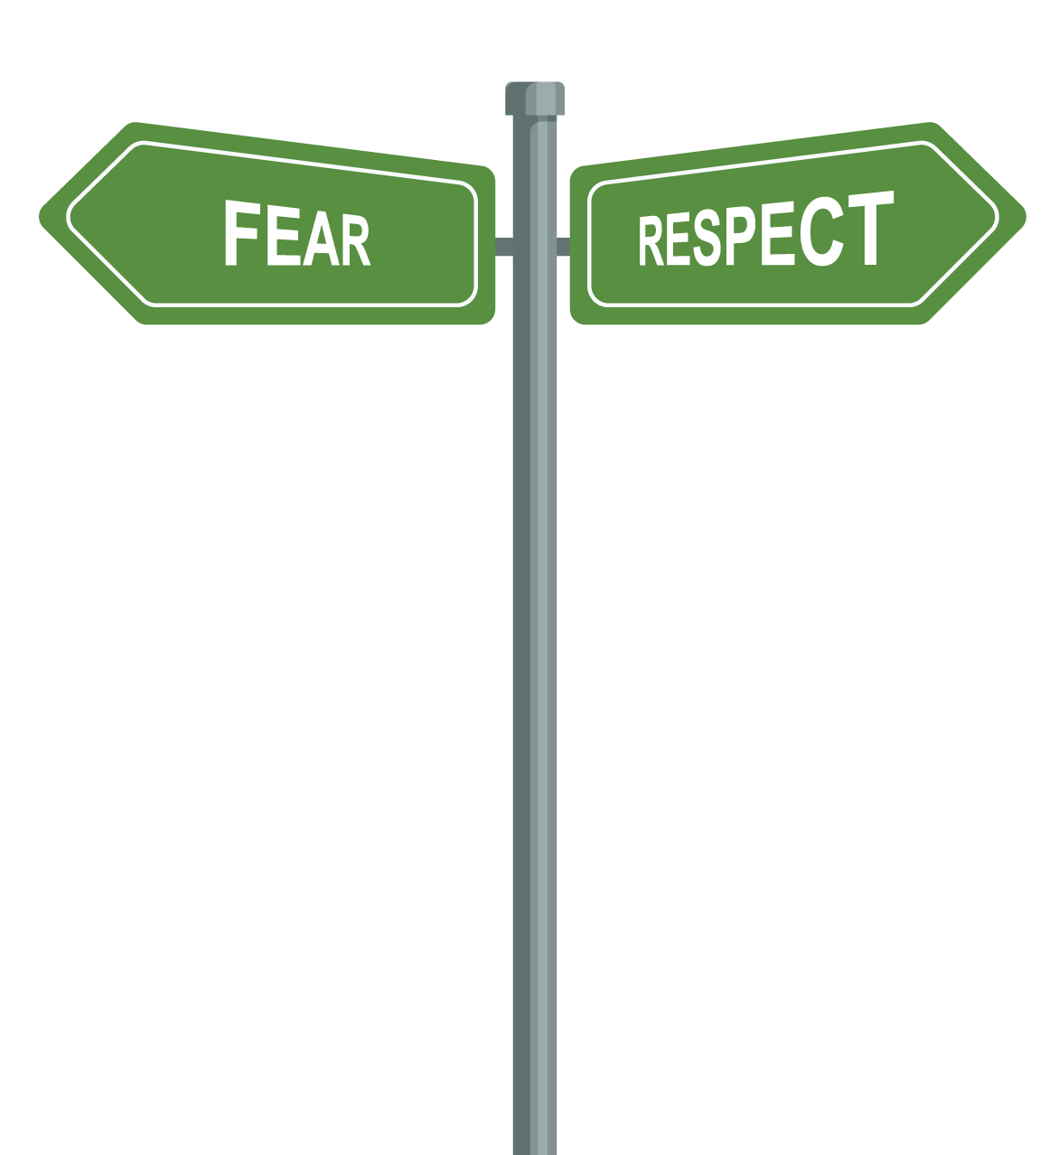
Empathetic Leadership: You decide how you lead
Leading with fear will keep your team with you, until something better comes along.
They will only produce what's expected to get a paycheck.
Leading with respect will create loyalty and dedication. Your team will produce what you can dream, there will be no limits.
They will want to do a good job and exceed your expectations.

Slide 13
Empathetic Leadership: Learn to light a fire within, not under

Slide 14
Empathetic Leadership
Simon Sinek – Leaders should have Empathy and Perspective
“It’s not about being ‘In Charge’ It’s about taking care of those ‘In Your Charge’”
What does that mean?

Slide 16
Empathetic Leadership
How can you show empathetic leadership from an equity lens?
Photo Credit: FreePik

Slide 17
Seek out opportunities to engage with employees Support the experiences of other people and engage in tough conversations about race and injustice. (Example: Courageous Conversations). Make an effort to interact with other people from different walks of life, as well as reading and watching the stories of those who are different from you, and don’t be afraid to ask questions.
Recognize and support your employees Take the time to acknowledge employees for exceptional work. Check-in on employees that are not high performers to find out if there are any specific barriers impacting their ability to succeed.
Learn to recognize and understand white privilege Use privileges that you have to empower others. This requires being aware of those privileges and acknowledging their implications.

Slide 18
Conduct an Employee Engagement Survey to gauge staff needs
Provide employees an opportunity to voice their ideas and/or concerns regarding the agency’s Diversity, Equity, Access, and Inclusion (DEAI) Program
Identify gaps that may be impeding career growth and development
Conduct an analysis of gaps within the agency regarding DEAI efforts
Identify solutions to address concerns and take deliberate steps to mitigate these gaps

Slide 19
Types of questions to include in an Employee Engagement Survey
Company culture
Demographics
Best forms of communication
Open-ended questions that allow people to provide details about issues or concerns
Inclusion and collaboration
Support from leadership
Opportunities for career growth and development

Slide 20
Listen and take action!
Review survey results with leadership team and develop initiatives
Address employee concerns
Provide transparency by sharing results
Develop KPIs (key performance indicators) to measure effectiveness

Slide 21
Create a safe and healthy environment for Courageous Conversations
The goal of these conversations is to:
Provide employees with an opportunity to share ideas and experiences which allow them to connect and come together.
Foster collaboration between colleagues by learning about similarities amongst one another.
Determine barriers that employees may be experiencing.

Slide 22
Lay out the ground rules for Courageous Conversations
State that the expectation is that participants commit to engaging with one another in an honest manner that is open-minded and vulnerable.
Include the following additional parameters:
Safe space for transparency
Speak your truth and don’t speak for others
Listen for understanding
Honor confidentiality
Ask if there are any additional ground rules participants would like to be considered for the future

Slide 23
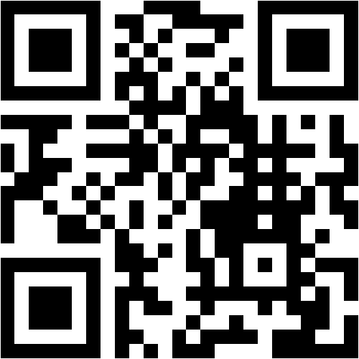
Feedback Request
Please Visit
www.menti.com
Enter Code
86 48 26 0

Slide 24
NEXT PART
Practice
MARCH 3RD, 2020
Putting DEAI in the center of an organization’s daily processes.

Slide 25
Feedback Request
Please Visit
www.menti.com
Enter Code
86 48 26 0

Slide 26
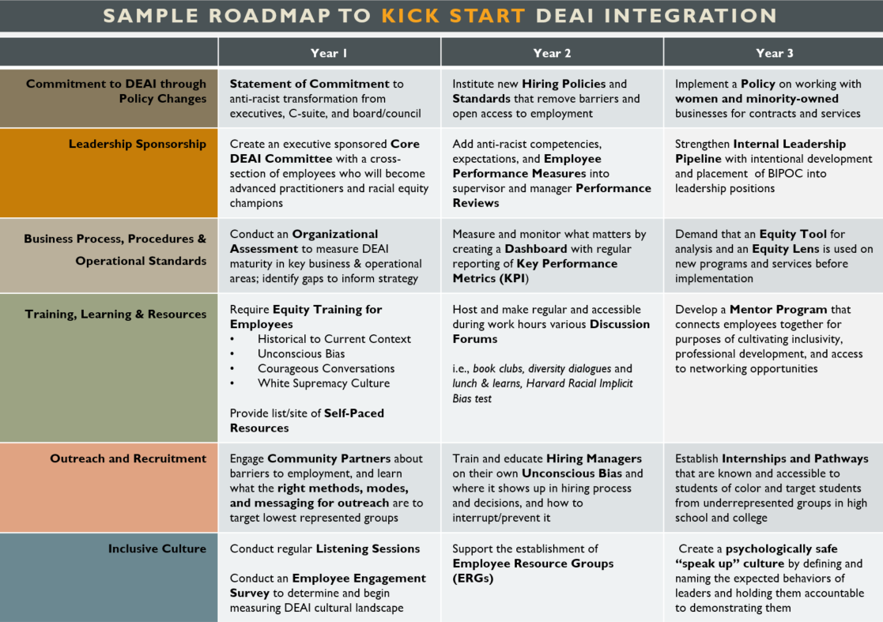
Resources
A new and growing library filled with starter templates and sample documents like the ones listed here can be found at:
www.pccetf.org/document-library/
Unconscious Bias - interrupters to use
Employee Engagement Survey - sample
Recruitment and Hiring Guide – sample checklists
Organizational Assessment – how to conduct an assessment
Employee Resource Groups - template and sample policy for affinity groups
Courageous Conversations Toolkit
Inclusive Meetings Tips
Intersectionality Exercise

