Slide 2
Lens of Equity Series
PART ONE
PART TWO
PART THREE
PART FOUR
SUMMIT EVENT
PEOPLE
PRACTICE
POLICY
PROMOTION
SUMMIT
February 3, 2021
The importance of organizational culture with the people in the center.
Recording available at PCCETF.ORG/LENS2021
March 3, 2021
How to put DEAI into practice and create an anti-racist and multicultural organization.
April 7, 2021
How to put DEAI in the center of an organization’s daily processes.
May 5, 2021
Highlighting organizations that are in the process of placing DEAI in their current practices.
June 18, 2021
Highlighting organizations that are in the process of placing DEAI in their current practices.

Slide 3
Organizational Structures Committee
DIVERSITY | EQUITY | ACCESSIBILITY | INCLUSION
Past projects
Housing of resources including a Lexicon, Resource/Educational Guide, and Organizational Assessment
4-part Lens of Equity mini-series.
Future projects
Lens of Equity Summit in June
Gold Standard Onboarding Process
Growing resources
Committee meets monthly on the third Thursday of the month at 10:00 am.
Next Meeting: March 18th at 10:00 am
Learn more at pccetf.org

Slide 4
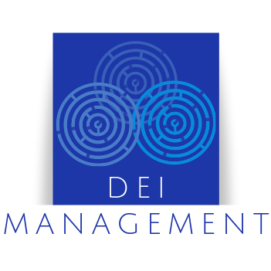
PART TWO
PRACTICE
TEAM MEMBERS
Putting Commitment into Action and Putting Culture into Practice
Lori Forte Harnick lorifh@goodwillwa.org
Nora Flemming de Sandoval nora.desandoval@americascarmuseum.org
Shondea Chapman schapman@batestech.edu
Dr. Cindy Caldwell DrCindy@DEIManagement.net

Slide 5
Continuum on Becoming an Anti-Racist, Multicultural Organization

Slide 6
Leadership, Data, Operations, Culture
Four Key Pillars to Building an Anti-racist, Multicultural Organization
Leadership must be on board and visibly lead the work
Data is critical to demonstrating the need for change
Change will not happen without an operational plan to put commitments into action
Culture is key – it must match the actual operations of the organization day-in and day-out

Slide 7
Leadership
Six Steps Leaders Can Take to Become Anti-racist
By Charlene Wheeless
Take a stand as an anti-racist
Communicate with genuine care and compassion
Understand the BIPOC-lived experience
Examine and address systemic racism in your organization
Embrace allyship
Use your clout to change social norms

Slide 8
Managing up: Make the Case
Recruitment & retention
Company reputation
Legal ramifications
Funding sources
2 million
$64B
$75k-$125k
Varies
Two million professionals leave their workplace annually due to unfairness and hostile work environments
The annual cost of turnover related to professionals leaving due to unfairness
The average direct cost of discrimination lawsuits
Mission, strategic priorities, policies and equity-focused implementation plans

Slide 9
Operations
12 Steps to Helping Your Organization Become Anti-racist & Multicultural
Adapted from Goodwill Industries International
Educate and learn
Align with core values and strategic plan
Obtain CEO/ED buy-in
Obtain Board of Directors buy-in
Engage Employee Advisory Council
Launch to the organization
Conduct an assessment to identify core needs
Set benchmarks and goals
Operationalize the work
Take it external
Measure and adjust
Continue to educate and learn

Slide 10
Culture
Are you interrupting White Standards & Dominant Culture?
Are you playing into bait and switch practices?
Are your organization’s DEAI efforts just checking the box?
Is your organization’s dominant culture eating your strategy?
Notes:
Be careful of the Bait and Switch
Define: Bait and Switch is a logical fallacy that occurs when someone presents a partial, appealing truth while hiding an unappealing falsehood
Lived Experience/Example: It is common to see a high # of BIPOC’s serving on the front line. Particularly, in student services, where the releational interaction begin, by building trust through the organizations brand. Once the Student or end user buys in, begins to experience the dominate culture norms & white standard on a daily basis. A bait and switch has occured. Distrust can occur over time. For higher ed you see the disconect in low retention and completation rates. Misrepresentation negatively affects culture and your brand.
Are your organization's DEAI efforts just Checking the Box?
Define: Going through the motions – behaving unintentionally and carrying out actions without passion or purpose.
Lived Experience: It is really important that your Organization DEAI efforts persist beyond agendas and Vague Anti-other statements with very little to no follow through, and committees with free BIPOC labor. It is important that your organization acknowledges how White Standards and norms show up and DOMINATE your daily operations. Once identified, include process/quality goals in your planning. Moving beyond the agenda. So all voices are heard at the decision making table. When or Org. Budget doesn't reflect what ou state your MIssion and Vision for DEAI alignment very little to no financial backing to do real, continuous work and training that actual impact culture. Your value statement should align with you budget.
Is your Organization’s Dominant Culture Eating Your Strategy?
Define: The culture of your company always determines success regardless of how effective your strategy may be.
Lived Experience: When the lived experience of the student and/or end user do not align with the mission and vision of the organization. Students struggle to connect and Question there value or place in the org. Are you spending more energy making resistent/definsive people comfortable? Instead of examining how racism is being practised and effecting your culture? Your culture is eating strategy. This happens when staff is shut down, afraid to give voice for fear of retaliation or marginalization. Your dominate culture is eating strategy.

Slide 11
College System Employees
Classified The Front Line
Enrollment Services & Student Service
Program Specialist
Workforce Service Representatives
IT Techs & Admin Assistance
Exempt Middle Management
Assistant Dean
Directors
Managers
Program Coordinators
Faculty Educators
Tenure Track Professors
Full-time & Part-time Teachers
Advisors
Adjunct
Administrators Leaders & Policy Makers
Board of Trustees
President & Vice Presidents
Deans and Directors
Notes:
This provides a visual of the higher ed employee structure. Which give context to BIPOC represtation in the community and at the decision making table.

Slide 12
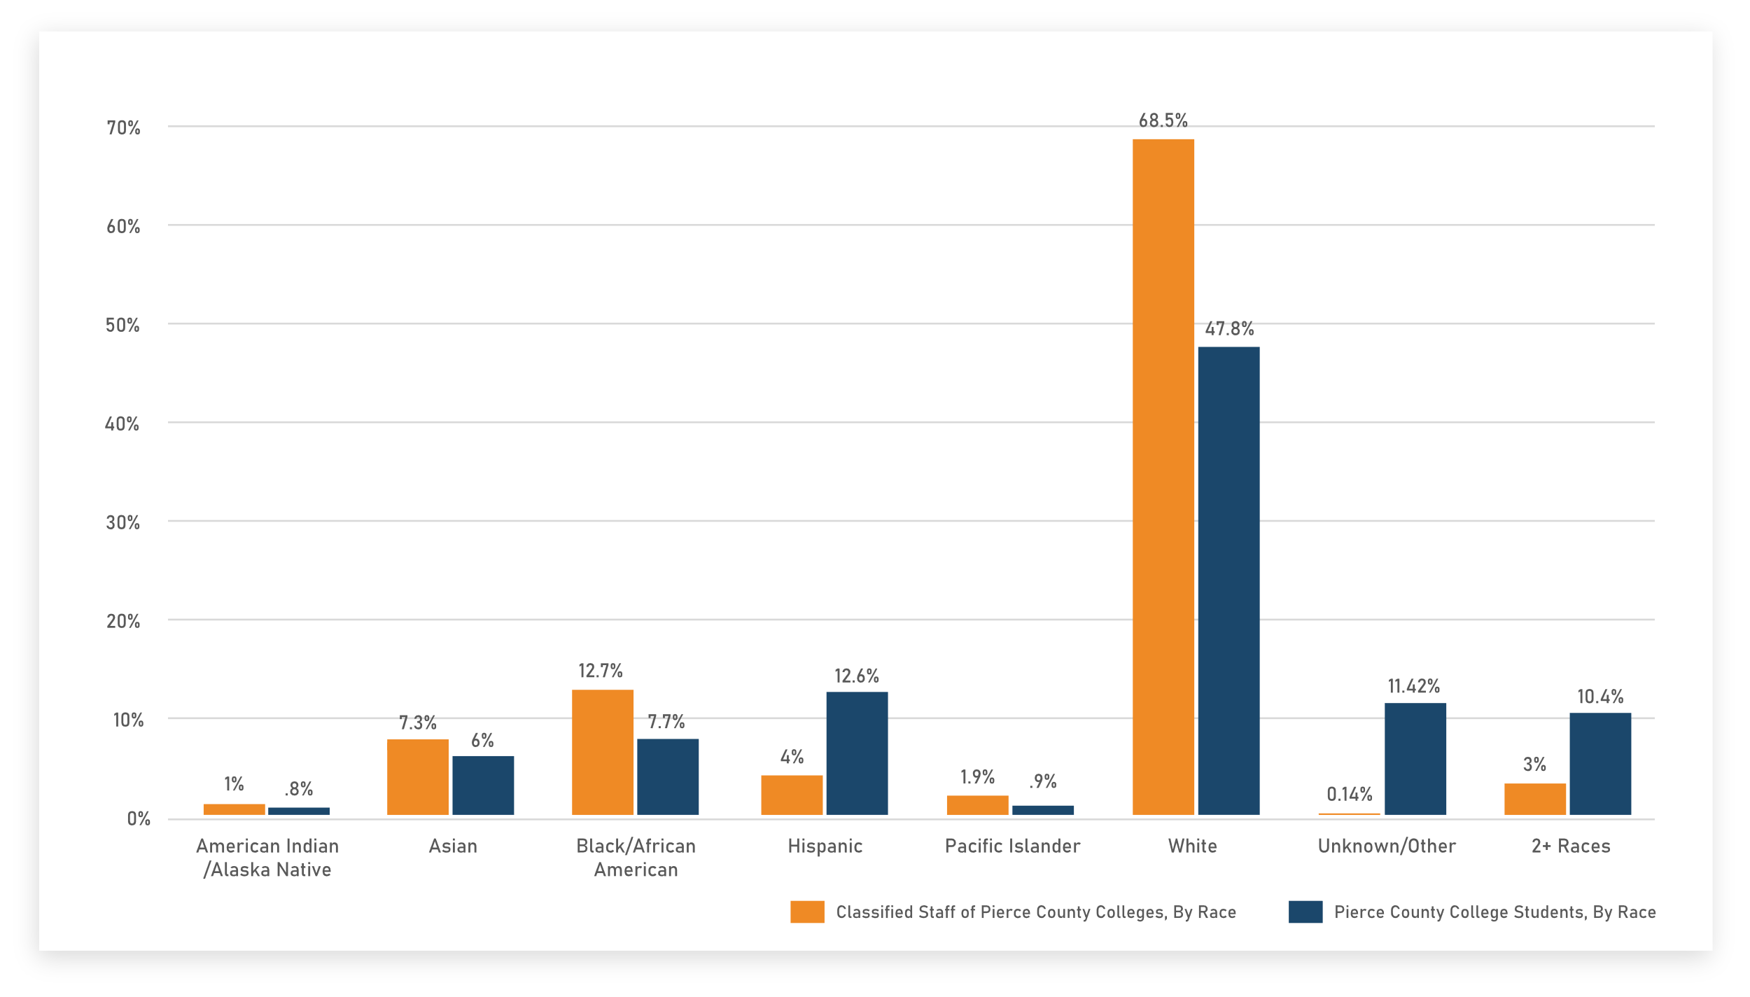
v
Classified Staff vs Pierce County College Students
Data from Pierce County and Washington State Board for Community & Technical Colleges
Notes:
Here you see the Demographic by race within our Community and Technical College system. Comparing our student population, to the BIPOC frontline/classified employee group.This employee group has the highest BIPOC representation of all employee groups. Yet the lowest in position of power.
17,496.00 Students (Pierce college, Tacoma Community College, Clover Park Tech, and Bates Tech)
8,357.68 48% White
2,197.02 13% Hispanic
1,998.12 11% Unknown
1,823.00 10% Two or more races
1,354.50 8% Black
1,052.02 6% Asian
442.06 3% Non-resident alien
162.54 1% Native Hawaiian/Pacific Islander
133.92 1% American Indian/Alaska Native
https://collegescorecard.ed.gov/school/

Slide 13
Overall BIPOC Faculty Representation
.01%
American Indian / Alaska Native
(51 / 3,495 employees, 15 in Pierce County)
17.6%
Asian
(617 / 3,495 employees, 66 in Pierce County)
3.4%
Black / African American
(120 / 3,495 employees, 53 in Pierce County)
.4%
Pacific Islander
(14 / 3,495 employees, 8 in Pierce County)
4.8%
Hispanic
(166 / 3,495 employees, 34 in Pierce County)
Compared to .8% within Classified Staff
Compared to 6% within Classified Staff
Compared to 7.7% within Classified Staff
Compared to .9% within Classified Staff
Compared to 12.6% within Classified Staff
Data from: Washington State Board of Education
Notes:
What we are seeing here is a low population of BIPOC faculty, the core of the organization.
Classified Staff still showing the highest % of BIPOC representation

Slide 14
BIPOC Representation within Administration vs Classified Staff
21%
of Administrators are BIPOC
(192 / 913 employees)
30.3%
of Classified Staff are BIPOC
(220 / 726 employees)
VS
Data from Washington State Board for Community & Technical Colleges, 2019 - 2020
Notes:
BIPOC representation at the administrative level is 192 out of 913 empoloyees( this is includes exempt & Administrative positions)
Front line, classified group has the highest representation within the 4 pierce schools, over 8 campuses. How often do you think the BIPOC classified group are invited to the decision making table? If a few are invited to the table, are there voice heard and part of the decisions making process?

Slide 15
BIPOC populations lack representation within positions of power
The Solution: Those in positions of power (Board Members, Hiring Managers, Administrators, Directors) must put the BIPOC populations they serve at the forefront.
Three immediate ways to show accountability:
Combating Bait & Switch Practices — DEAI efforts should be evident in your daily operations and in every process and layer of your organization.
Move Past “Just Checking the Box” — Economic empowerment
Welcoming and Embracing Culture Change — Understand that discomfort is the root of all growth and learning. Welcome it!
Notes:
1. Combating Bait and Switch practices - BIPOC representation and contirbution should persist within your process and practises.
2. Move Past Just Checking the box - Economic Empowerment is key. Your budget should align with your core values and stratefic plan. Free of tokenizing and free BIPOC labor
3. Welcome and Embrace Culture Change- Discomfort is the root of all growth and learning. Please don't fall into the trap of avoiding or comforting those who are defensive/resistant. It will get in the way of your DEAI progress and Mission.

Slide 16
v
Continuum of Change Organizational Assessment
Notes:
I’m going to be talking about assessments. There are many different versions out there and I know that the Policy group will be talking about policy assessments next month. Assessments are something to give you data, something to create a foundation that you can build on, WHICH Lori and Nora already emphasized. Organizations want to know that they can MEASURE - improvement, decreased turnover costs, improved job satisfaction and productivity etc. And if the true end result is that we want to create pro-equity, anti-racist, anti-sexist, anti-homophobic people…we need to have data to build on for that as well.
So, you all should be familiar with this assessment, as it is the one Org Str we put together last year. It is in the welcome packet, on FB and the webpage. It is a great starting point, especially if you are doing this work in-house, without a consultant or are just beginning your DEAI journey.

Slide 17
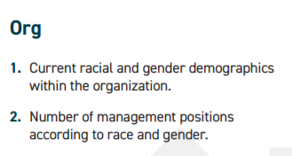
The 828 Tracker Assessment Worksheet
v
v
v
v
v
Notes:
This is Lawrence Garrett’s assessment tool and in it he asks questions about racial and gender demographics in the organization, in staff, and leadership, as well as regarding promotions, salary, & discrimination complaints. For example:
Staff - How many and what kind of affinity groups? Do any have any DEI training? Are there problem staff members? Does the organization only honor Christian holidays? Are there floating holidays?
Leadership – any DEAI training? Are they leading any DEAI trainings? Implicit bias training? Do they belong to any affinity groups? Lori talked earlier about leadership taking a strong role in DEAI training…is there commitment?
And then goals – where do you want to be in a year? What numbers should you be seeing and what changes will have been made? These are all questions to get you started on a strategic plan.

Slide 18
Anti-Othering
Action is the deciding factor.
Anti-racist
Anti-sexist
Anti-homophobic
Anti-discrimination
Anti-profiling
Anti-stereotyping
Notes:
We talk a lot about being anti-racist. Ibram Kendi in his book, How to Be An Anti-Racist, says we are either racist or anti-racist. This is true for every demographic. When we “other” someone, we are setting them apart, making them “less than”. And the difference in being racist or anti-racist is action. The only way to become anti-othering, is to take action.
To break it down further – you are either sexist or anti-sexist. What action are you taking to become anti-sexist? What action to become anti-homophobic?
Kendi goes onto to say that if you think you are anti-racist, but you are still homophobic, you aren’t anti-racist for the simple reason there are Queer Black Indigenous POC. If you think you are anti-racist but you are not looking at your own sexist bias, you aren’t anti-racist, because there are WOC being discriminated against. And the inverse of these are true, as well.
And this is hard work. It takes courage and persistence, a willingness to make mistakes and try again. I wonder how many mistakes you will find in my presentation today? but I will improve because I will keep trying.

Slide 19
The IDI and Perceptions of Diversity
Intercultural Development Continuum (IDCTM )
Notes:
The Intercultural Development Inventory® (IDI®) is the premier cross-culturally valid assessment for building cultural competence in your school or organization”
The Intercultural Development Inventory or IDI is about assessing your cultural competence. It’s a personal and organizational assessment – because, after all, for things to improve, we have to improve as individuals, which then is reflected in the organization. And organizations have their own culture.
How well do you move from your own cultural bubble and into someone else’s? Does the culture of your organization play well with other organizations, the city, etc?
Note the levels on the journey to becoming culturally competent…denial, polarization, minimization, acceptance and adaptation.
But what is culture?

Slide 20
Intersectionality is Culture
Notes:
The term intersectionality was coined by Dr. Kimberle’ Crenshaw to highlight the challenges of racism and sexism that women of color face. It has since been used to explain our sense of personal culture.
Personal culture IS about your intersections - influences, beliefs, gender identity, where you grew up, 2 parents, single parent, same-sex parents etc etc. Cultural competence is valuing differences, learning from those differences and being able to not give offense when moving within another culture. It does not mean that you agree with everything in another culture, it means valuing the differences.
So let’s briefly talk about the different orientations of the IDI – which outlines the cultural lens that we use to see the world.

Slide 21
Stages of the IDI Denial
Don’t Even kNow I Am Lying
- Emmanuel Acho, Uncomfortable Conversations With a Black Man
Notes:
Mike Pence leading the caucus on women’s health. Denying that women need to be in the room.
Emmanuel Acho said the anacronym of denial is “don’t even know I am lying”.
Don’t even know that it is a lie that women are needed in that room.
Dominance and fear lead this stage and is a monocultural mindset, not needing to see any culture but one’s own.

Slide 22
Stages of the IDI Polarization
Notes:
This is Leshia Evans, a nurse from Baton Rouge. Polarization is “power over”, us vs them, I’m right and you’re wrong. Polarization can also have a reverse orientation, where a person doesn’t value or understand their own culture. One example of this is a person from another country, really wanting to fit it. She may try to hide her cultural differences so that she doesn’t stand out.
Polarization is also a monocultural mindset.

Slide 23
Stages of the IDI Minimization
Notes:
Minimization is the bridge between the monocultural mindsets of denial and polarization and the multi-cultural mindsets of acceptance and adaptation. Minimization is starting to wake up to some injustices, but mostly just wants to “get along”.
This may be the peacemaker in your family or organization, but they are not looking for justice, they are not yet willing to be uncomfortable, not yet looking deeply at their own bias. However, minimization is the bridge we all have to cross to get to the next orientation.

Slide 24
Stages of the IDI Acceptance
Notes:
Dr. Angela Davis turned the serenity prayer into a social justice statement. Acceptance is recognition and appreciation of cultural differences and values, but may still be hesitant or even get stuck in knowing the right thing to do. And know that none of us get into one of these orientations and just stay there – we are moving more like a pendulum as we become aware of new concepts and work to move through these mindsets to value differences.

Slide 25
Stages of the IDI Adaptation
Notes:
The story goes…adaptation is the effective use of empathy or being able to shift your frame of reference, to understand and be understood across cultural boundaries. Again, it is the ability to shift your frame of reference to become competent – not give offense – in another person’s culture. It is to use empathy, when navigating cultural differences.

Slide 26
The IDI
Is a practical tool to start an individual and an organization on their journey to becoming culturally competent.
Notes:
The IDI is a practical tool to start an individual and an organization on their journey to becoming culturally competent. It gives a baseline for both the individual and the organization to start from, giving specific information on what the growing edges are.
So these are a few examples of organizational assessments and what can be done with them.
Thank you to this team for their time, their commitment and their expertise in this presentation. Elise Bodell and Auby Clark were are part of the team early on and added a lot of great ideas, but life got crazy for them and so couldn’t continue with our meetings. Nevertheless, they were an integral part of the team. All were a joy and inspiration to work with!

Slide 27
Resources
A new and growing library filled with starter templates and sample documents like the ones listed here can be found at:
pccetf.org/document-library
PCCETF Continuum of Change
Continuum to becoming an Anti-Racist and Multicultural organization
Eight-Twenty Eight’s 828 Tracker Assessment Worksheet
6 Steps leaders can take to become Anti-Racist
IDI Inventory information
Dare to Lead podcast with Darlene Brown

Slide 28
NEXT PART
POLICY
APRIL 7TH, 2021
How to put DEAI in the center of an organization’s daily processes.

