Slide 2
Lens of Equity Series
PART ONE
PART TWO
PART THREE
PART FOUR
PEOPLE
PRACTICE
POLICY
PROMOTION
February 3, 2021
The importance of organizational culture with the people in the center.
March 3, 2021
Addressing policy and procedures to create equitable and inclusive practices.
April 7, 2021
How to put DEAI in the center of an organization’s daily processes.
May 5, 2021
Highlighting organizations that are in the process of placing DEAI in their current practices.

Slide 3
PART FOUR
TEAM MEMBERS
PROMOTION
Lawrence Garrett
Delia Flores
Abigail Vizcarra Perez
Courtney Acoff
Sherese Gamble​
Jaime Prothro
Kristina Cintron

Slide 4
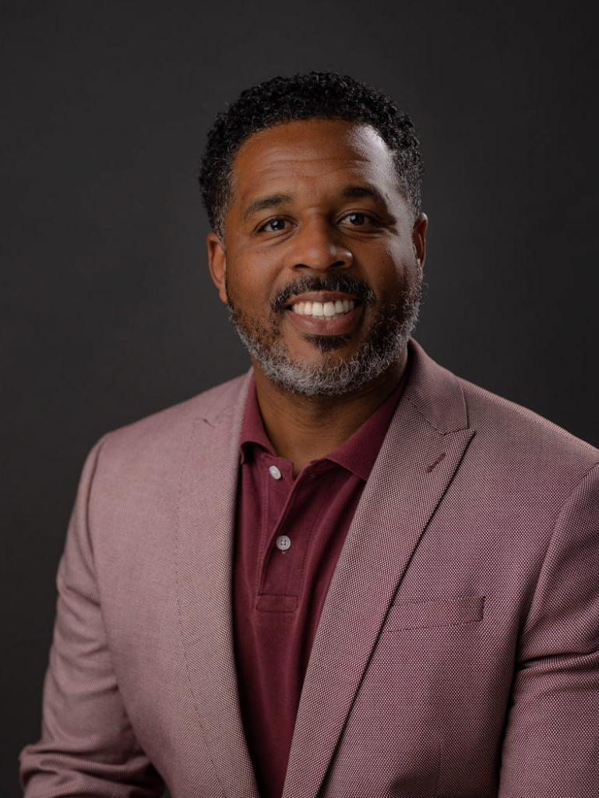
Introduction
Lawrence Garrett
Culture Designer

Slide 5
Jaime Prothro
Customer Experience Director
Kristina Cintron
Facilities Manager

Slide 6
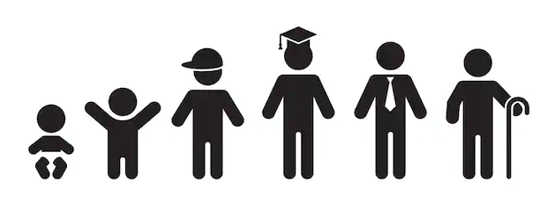
Spaces | Collections | Programs & Initiatives | Partnerships | Technology | Staff
LEARNING • ENJOYMENT • COMMUNITY

Slide 7
PCLS employee word cloud of the impact of in-service training in 2016

Slide 8
PCLS Groundwork for EDI
5-year Diversity and Inclusion Plan
Levy reauthorization, resulting in public services reorganization
2017 Urban Libraries Council statement on Social and Racial Equity
System-strong thinking

Slide 9
CE Department Reorganization
400%
$1.5M
100%
5
2
Increase in personnel to support Teen Services
Investment in department staff to engage community outside of facilities
Customer voice and customer centricity in job descriptions
New leadership positions that do not require MLS degree
Strong career pathways for advancement: paraprofessional and professional
RESOURCES
Gale Analytics | Census 2010 | Workforce Force of the Future Report
ALA Libraries Transforming Communities | Palaces for the People, Eric Klinenberg | Reinventing Organizations, Frederic Laloux
GARE Advancing Equity in Public Libraries: Cases from the field

Slide 10
PCLS Culture Shift
How do we bring all levels of staff and perspectives into the conversation?
Who can help us work through this and hold us accountable?
What does a Diverse, Equitable, Inclusive AND Anti-Racist Library look like and what are the behaviors to support it?
What has been accomplished and what was the impact?
Why now and what are the priorities?
How will we allocate time, budget and resources to move the work forward?

Slide 11
Intentionality & Continuous Improvement
VISION
Our vision is that all teens in Pierce County have equitable access to relevant resources, culturally competent connections and mentorship, and learning opportunities tailored to the unique characteristics of the community and supported by a network of invested partners and advocates.
The community understands that Pierce County Library System plays an essential role in providing access and opportunities that center teens’ self-expression, self-efficacy, sense of community, skill-building, and literacy.
Initiative Impacts
Teams (chartering EDI)
Leadership commitment
Teen Services

Slide 12
Intentionality & Continuous Improvement
MISSION
To provide equitable teen-centered library services and resources to all members of the community.
GUIDING PRINCIPLES
Teens are the experts in their own experience.
Teens should have a voice in the decisions that affect them.
Teens should have access to learning opportunities that incorporate their backgrounds, identities, interests, goals, and social relationships.
Teens should have access to relevant resources and services.
Teens should have access to a network of supportive relationships that meet their needs.
Teens thrive when supported by trusted adults.

Slide 13
Promoting EDI Through Service

Slide 14
The Ground Work Reforming Schools to Fit Black & Brown Families
Sherese Gamble, M.Ed

Slide 15
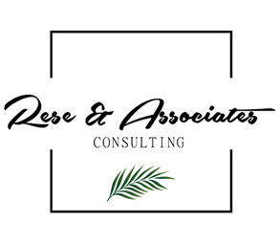
The Table
“Diversity”
Tells us who is seated at the table.
“Inclusion”
Tells us that those seated are heard.
“Equity”
Tells us those at the table have the things they need to thrive.
“Access”
Tells us the opportunity the table creates to intentionally include everyone.

Slide 16
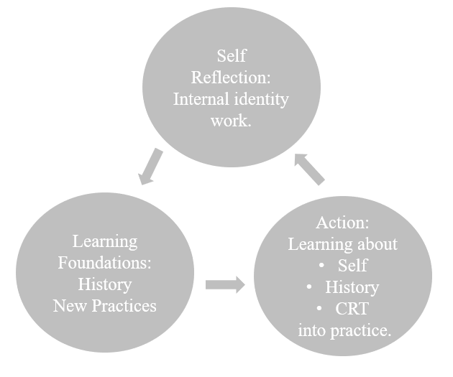
The Journey
“Belief Gap”
The gap between what students can achieve and what others believe they can achieve.
“Achievement Gap”
Let’s frame the problem in a way that is accurate and allows us to hold everyone accountable for student outcomes.
“Opportunity Gap”
Because when given the resources and opportunities they deserve, all kids can and should achieve.​

Slide 17
Self-Reflection: Internal Identity Work
Step One: The needed self-reflection and awareness of your own role in racism and racist structures.
Reflecting on your own racial journey is important for understanding:​
Yourself​.
Your relationship with others​.
Your position in the world.
How you show up for your students authentically.

Slide 18
Self-Reflection: Internal Identity Work (cont.)
Our ethnic and racial identities are influenced by:
Our Experiences
Our Families
Popular Media & Current Events

Slide 19
Learning Foundations: History, Systems, New Practices
Step Two: The needed foundational learning of true history, systems of oppression, and social emotional learning + restorative practices + culturally responsive teaching.
What were you taught in K-12 about American History?
Deepen understanding of accurate historical contexts, systems of oppression and their impact on the educational system, our school and our individual practice.

Slide 20
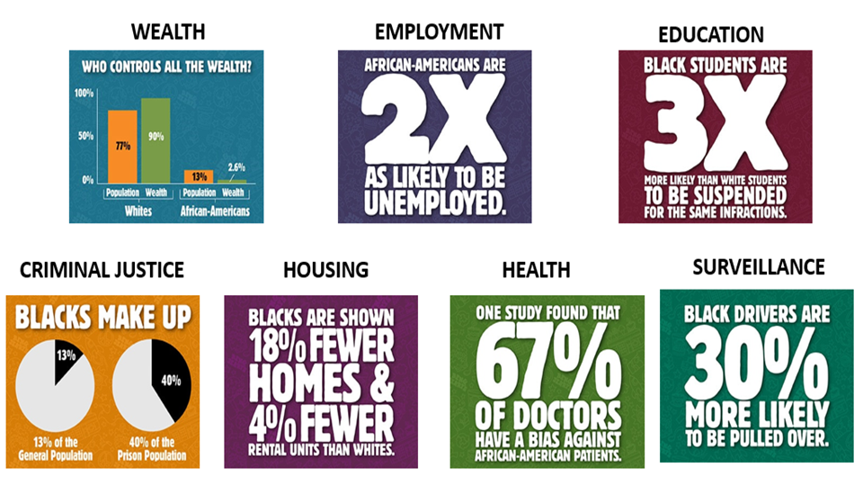
Learning Foundations: History, Systems, New Practices (cont.)

Slide 21
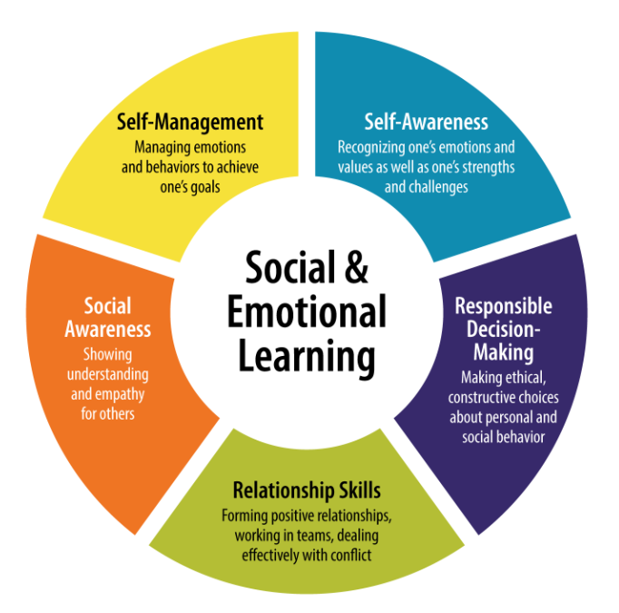
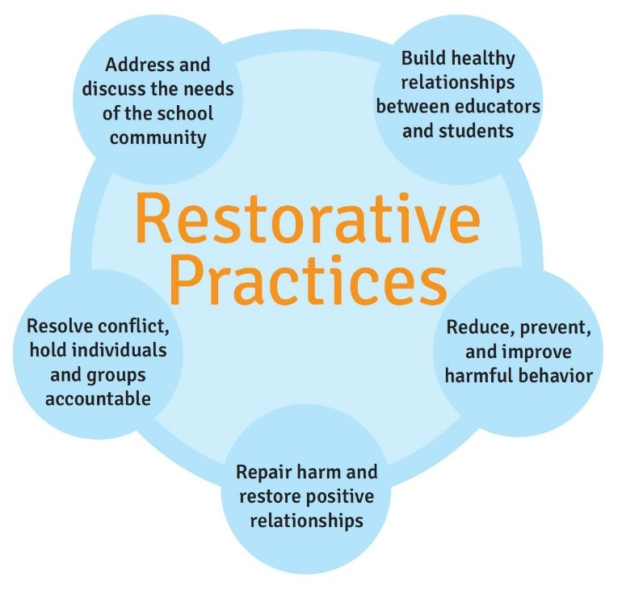
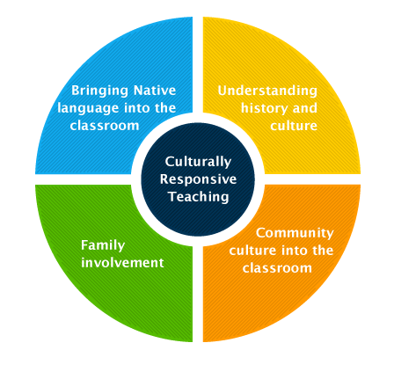
Learning Foundations: History, Systems, New Practices

Slide 22
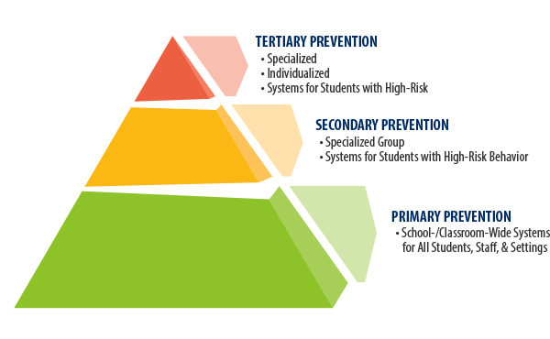
Learning into Action: The Work
Step Three: The needed action planning and centering of students, families, and community voice to move learning about self, history, and new practices into our systems, schools, and classrooms.

Slide 23
Governmental Organization: Metro Parks Tacoma
Notes:
Every organization – whether brand new or 150 years young – fosters a culture. It doesn’t have to be acknowledged to exist, but it must be nurtured to thrive, empower employees, and to have it contribute to the company’s goals, growth and longevity.
If your organization doesn’t currently have a defined culture, that’s ok. We’ll get there. And if it does, there’s always room for improvement.

Slide 24
Promotion as Truth Telling
"If you have come to here to help me you are wasting your time but if you have come because your liberation is bound up with mine, then let us work together."
- Lilla Waston
Notes:
Promotion within is the lever of change and organization shift through equity, diversity, and inclusion efforts. It is the pathway to organizational culture change – it reinforces desired behaviors and discourages undesired practices.
So much of the work I do is to act like a mirror: I reflect back to people; what they look like. This is sometimes uncomfortable-whether I'm sharing about something to be proud of or something that needs to change.
In promoting our work for inclusive procurement I have become aware that our organizational culture is shifting.

Slide 25
Cultural Renovation
We no longer allow ourselves to neglect hyper local priorities even if the regional codes do not directly apply.
We no longer expect perfection when we make attempts to change our systems.
We no longer see competing priorities as a barrier, rather an opportunity to improve in all areas.
We no longer hold the minority in competition with the majority (as is the default for gov. agencies in a democratic context).
Notes:
It's important for me to name the shifting attitudes toward the internalized aspects of dominant culture that thrives in competition, perfectionism and false dichotomies and paternalism. I'm naming just four of the major shifts I've encountered in the last few months because these are just beginning to surface as the first blossoms that I hope will mature into the fruits of our labor.
This year I have been invited to expand into a full-time position to take on contract equity and inclusive procurement
that I mentioned earlier. This project is evidence of the changing culture at our agency… the next steps we are taking are new ways of walking the talk.. And it is an important case study in how we are behaving as we learn what it means to be an Anti-Racist agency.
[read bullet points]
We were able to make these shifts but it starts with a passion for Collecting and Disaggregating data in order to reflect, engage and change.
To engage the most vulnerable communities, it is important to conduct a data analysis by disaggregating data by race/ethnicity, gender, age, geographic area, income level or by other indicators that are relevant for each neighborhood in the service area. Disaggregated data shows how outcomes vary by community and/or neighborhood. The disaggregated data provides a new view of the issue at hand and helps identify the greatest inequities.
Here is what I mean:
If you look at our staff configuration, you’ll see a pretty typical parks- agency configuration. If you disaggregate the data you’ll see how rare it is for MetroParks to hire people of color for full time positions. If you disaggregate and hone in on long term staff, you’ll see how long people of color work for the agency before becoming full time, if we do at all. Or you’ll see what kinds of positions we hold.
You may have noted that I have described myself as a person of color and included myself in this group…and wondered how someone who looks the way I do is a person of color. I look like I am anglo because I have Caucasian and Basque heritage mixed with indigenous Mexican heritage. Being a person of color doesn’t require that I have more melanized skin. Rather, I know I am a person of color because of my ethnic heritage and lived experience. Put simply, I came to understand that I am treated as a person a of color because of my behaviors and beliefs that do not allow me to have an insider’s perspective or relationship to the dominant culture that is preoccupied with skin color. I cannot ever know what every person of color experiences. I can only confess that my experience is the source of my passion for the work I do to work with people who do not have access to the resources that exist for me through our agency.
This matters to MetroParks because our agency has made Anti-Racist commitments that it cannot uphold unless we learn to treat people as individuals, with unique experiences from which they derive expertise. In our commitments to anti-racist practices, MetroParks has chosen to track the truth about our agency and our biases and look for ways to improve the way we treat employees like me. The agency can’t fix what we cannot see so the decision was made to track real data. Then we realized we can’t solve the problem for the individual without the individual participating, Metro Parks needs me to actively participate.
It is a both a burden and a privilege to do this, one that I gladly take on because I do have a certain amount of white privilege. The agency invited me to self-identify as Hispanic/Latina so that HR can track the length of my employment, the length of my part time status, my professional goals, my unique configuration of qualifications and the type of work I do in service to the greater good of biracial or bilingual employees or candidates. My superiors can act to promote me or retain me knowing the burden and privilege I carry and I can track opportunities within the organization, such as certifications in diversity consulting or the potential for translation compensation that make the most of my cultural identity as I become eligible for such promotions and understand how to meet performance goals set with my unique qualifications and cultural expertise in mind.
I support the disaggregation by offering up a certain amount of personal information so that I am viewed as a particular part of the whole and we can track the agency in meeting it’s goal of employing a workforce that represents the population and priorities of the service area. I am fully aware that poses a risk to me professionally and personally but I take on the risk because I choose to use my privilege -my light skin, my master’s degree are just a couple of the many privileges I have-that I use to support others who have told me about their needs for access to employment.

Slide 26
Build on the DEAI work to that will shift organizational culture, policies & procedures, methodology of service delivery and redevelopment of anti-racist practices
Show that when organizations like Metro Parks have achieved workplace inclusivity, both their staff and their end users are much better equipped
Act on the opportunity to resource and model a new normal that is defined by the people impacted by decisions
Notes:
I'm going to elaborate a little more around cultural renovation. There is a podcase that I listened to by Kevin Oakes with Rene Brown that discusses the term 'cultural renovation'. They talked about it in way that made so much sense to me. “With a metaphor as renovating a culture is like renovating a beautiful, historical, old house. There are so many things that are foundational to an organization, foundational to the historical house that makes it what it is and is about knowing what to keep and knowing what to change and the why? Culture renovation will face some resistance but it is sometimes necessary. It is renovation! Were going to take this house that was built in the 1920’s and bring it up date, up to code. We will keep what is special about our traditions, our culture (when necessary), what is special to us but we also up the Wi-Fi and we will be able to turn on the light.”
Building on DEAI work that leads to a shift in organizational culture, renovation, policies and procedures is critical. As an organization, its important that you not only do the work internally, but show externally that when you achieve workplace inclusiveness it is a stronger work place environment. And lastly, acting on the opportunity, based on the drastic impacts of social injustice and COVID-19, leaders should realize that we are all being presented with an opportunity to rise to the challenge to reopen your doors as stronger organizations.

Slide 27
The Internal Shift
Leaders set, guide, and are responsible for the trajectory of the organizations they serve. Good, bad, or indifferent, leaders have the positional power to decide how the organization will respond to pivot and move through this tumultuous time.
Now is the time for leaders to carefully explore and answer some critical questions that will set the tone and direction for their organization.
Notes:
Around the world, senior level leaders are very concerned about issues connected to Diversity, Equity, Access and Inclusion (DEAI). However, many do not understand that culture, innovation, engagement, relationships, operational excellence and leadership are all tied to an organization's equity and inclusion practices. Leaders set, guide, and are responsible for the trajectory of the organizations they serve. Good, bad, or indifferent, leaders have the positional power to decide how the organization will respond to, pivot, and move through this tumultuous time.
Now is the time for leaders to carefully explore and answer some critical questions that will set the tone and direction for their organization.
An equitable approach to this dynamic is possible. If and when executives share the burden of
communication, risk assessment, emotional intelligence and when they can provide clear, consistent guidance in writing and in verbal commitments.

Slide 28
Codifying Promotion
Metro Parks Tacoma Board Resolution Addressing Racism – RESOLUTION NO. R32-20
Actionable commitments that can be added to program documents
Verbiage for accountability and workplan details
MPT Stated Core Values Equity Access & Inclusion
How will the end-users, non-users and new users hold us accountable to this stated goals?
Notes:
MPT is classified as a special district of city government. Our elected Commissioners are responsible for representing the concerns of constituents. Our Executives listen to their directives and draft policies that will abide by local and national standards. When a policy is approved, subject matter experts interpret those policies then write programs and develop real properties in order to support the actions outlined in the policies.
One type of response to the policies has been to study internal effectiveness and public priorities. The most recent began before we entered into COVID Incident Command Structure. This formal assessment of organizational structure, internal operations, systems, and culture took ICS into consideration and held us to a higher standard. Our pandemic response is not sustainable but seeing leadership activate in more efficient manner caused everyone to question why we had been inefficient or why we had not prioritized the most vulnerable populations in the past.
Likely because there was never sufficient mandate to promote or codify promotion of the DEI focused components in our vision, mission, values.
In response to the murder of George Floyd MPT drew up a resolution, just like many other agencies and corporations, in order to promote their commitment to DEAI work.
But we are still working on the practical application of the resolution.
We are discussing and promoting certain elements such as actionable commitments, accountability measures related to workplans and deliverables and reminding everyone that DEAI is a long term stated goal...
We publicize these here so that you can hold us accountable to these resolutions, values and such.
Our resolution will be meaningless bureaucracy unless we can hone in on executing the daily tasks and resolve to improve interactions each individual employee takes on. Our policies, assessments and programs are going to continue to evince our implicit bias unless each person who works with and for the agency has made a personal commitment to these stated values. Courtney will speak more on how to build a more positive organizational culture, there are many steps you can take to improve relationships and foster growth. Many impactful changes are small, and occur at a relatively granular level. These changes are typically quicker, and cheaper, to enact than large-scale shifts. These small changes can be organized into two categories: relationship building, and opportunity giving.

Slide 29
Employers can use the following tips to help build a positive corporate culture at their workplace:
Emphasis on employee wellness.…
Grow off your current culture.…
Provide meaning.…
Create goals.…
Encourage positivity.…
Foster social connections.…
Listen....
Notes:
Promoting culture boils down to one fundamental necessity: Leadership must walk the walk. When employees see and hear you embodying the values, practices and beliefs you established, they are more likely to buy-in.
A culture that places a prominent focus on wellness not only empowers and encourages employees to continuously make healthy behavioral choices, but it also shows your employees that you are committed to investing in them as individuals.
Growing off the 'where you are now' is important. It doesn’t have to be a perfect system, in fact, there is no such thing as a perfect system. This work takes time, and commitment. It takes building strategies that leadership has committed to, to redefine what the culture will look like moving forward.
Providing meaning, its important for internal staff to understand the WHY. Why are you committed to this work? What does it mean to be an accountable organization that actually wants to re-shift the culture? Does your staff understand why you are moving this way? How have you educated your staff on the internal goals that the organization is focusing on with this shift in culture?
Creating Goals, this is vital for growth and measurement. State clearly to staff what the end goal is. If everyone is on the same page on the end goal, you have a higher chance of success because everyone has committed to reaching the end goal. Ask your staff what their individual goals are and see how you can leverage that to make sense to the organizations end goal.
Encourage positivity. It is so important to ensure that your staff feel encouraged. Feeding the soul of your employees only benefits the community in return. After all, the work environment you’re building belongs to your employees, and they will be directly affected by every decision made, every day of the week.
When employees feel a part of the process – especially really impactful ones – they’re more likely to feel invested in the company and become more engaged. The more engaged employees are at work, the less likely they are to leave/turnover, which ultimately impacts a company's bottom line. It costs employers 33% of a worker's annual salary to hire a replacement if that worker leaves.
Building social connections in the workplace doesn’t have to mean that all employees should be best friends or that everyone gets along all the time. It’s about fostering an environment that supports mutual respect, trust and belonging among peers. If you’re a leader, you not only have the power to strengthen your own connections, but to foster a work environment that values, instead of hinders, social investment.
And lastly LISTEN. Listen to your employees, A listening strategy is a deliberately planned and orchestrated approach to obtain relevant insights from or about employees. Listening by itself has a positive effect on engagement, as it provides a channel to provide feedback and it shows employees that their voice is relevant and heard, with the end result of empowerment and promotion within. The term “listening” should by no means be taken literally. It is only an analogy that comprises any kind of activity that intends to capture relevant input from potential, current or former employees. This input helps the organization to better understand the employee’s standpoints, opinions and motivations. There is a wide range of data sources and formats to tap into, such as interviews, surveys, participation data, processed data, unsolicited feedback posted on external websites (e.g. Glassdoor, LinkedIn), or typical KPIs such as attrition, just to name a few.

Slide 30
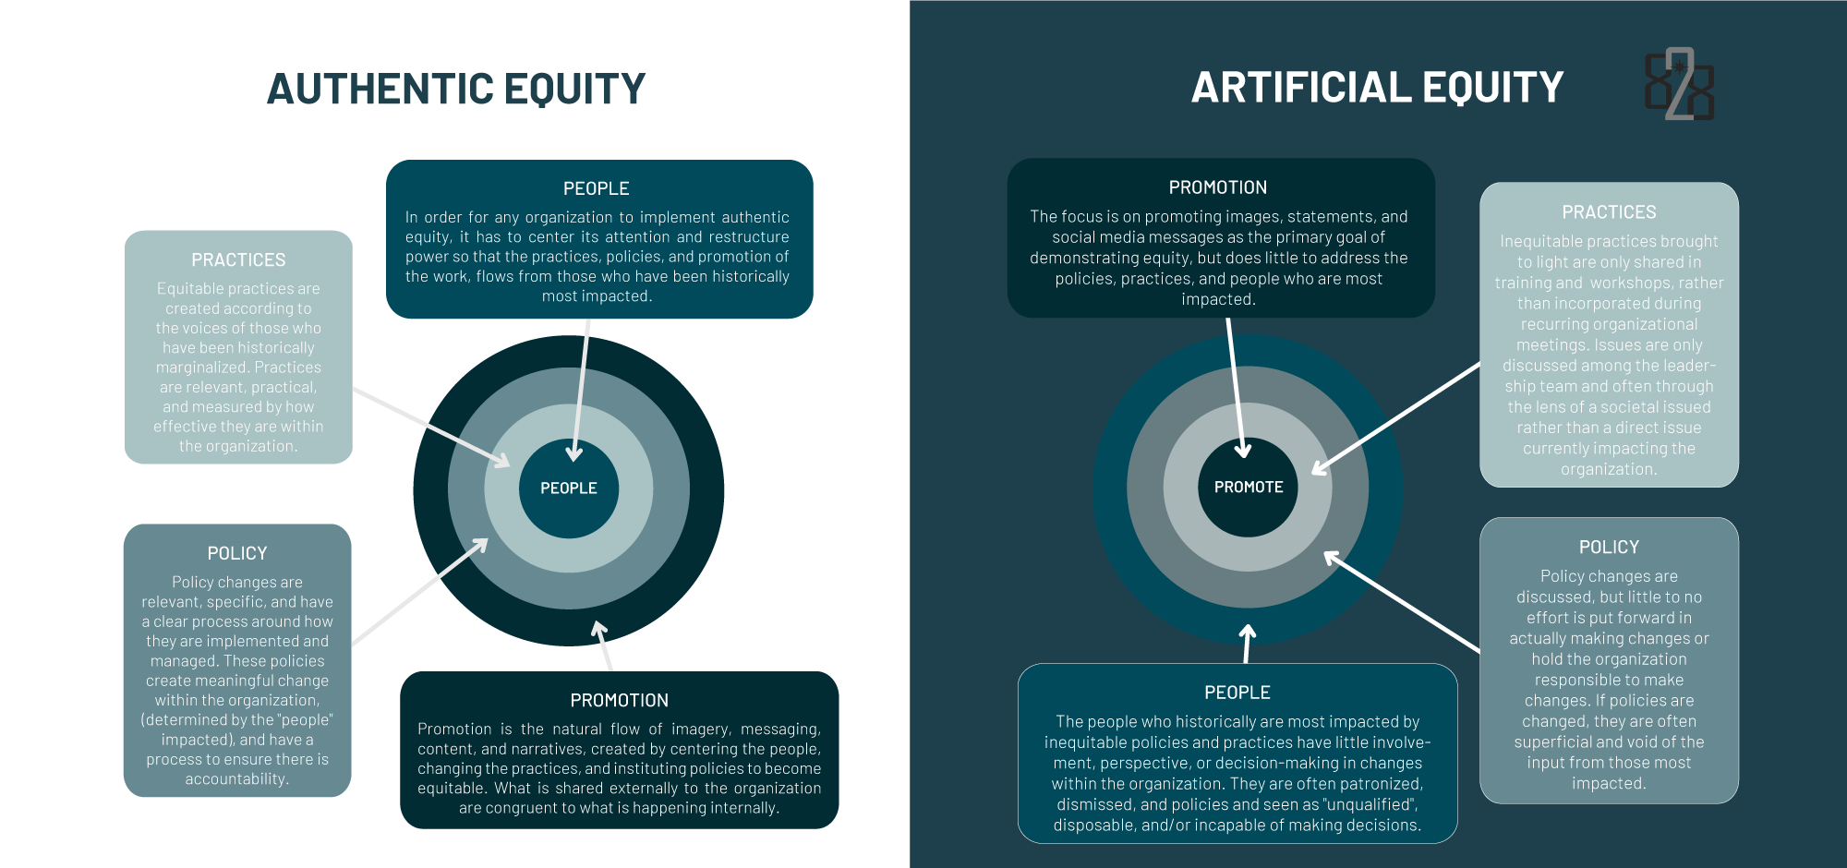
PART FOUR
PROMOTION

Slide 31
Authentic vs Artificial Equity
“Organizations practicing authentic equity, centers the people, polices, practices and promotion on those how have historically been most marginalized.”

